Slide 1
Week 9 Updates Shapiro
By Evan Johns

Slide 2
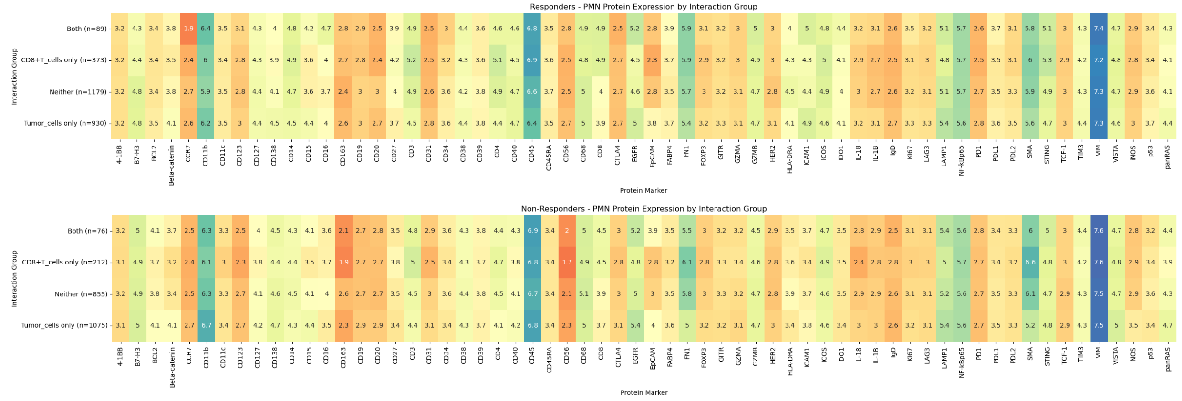
Overall Protein Heatmap
Responder
Non-Responder
Notes:
Between two samples there may be significant variation but on aggregate these changes mostly cancel each other out.

Slide 3
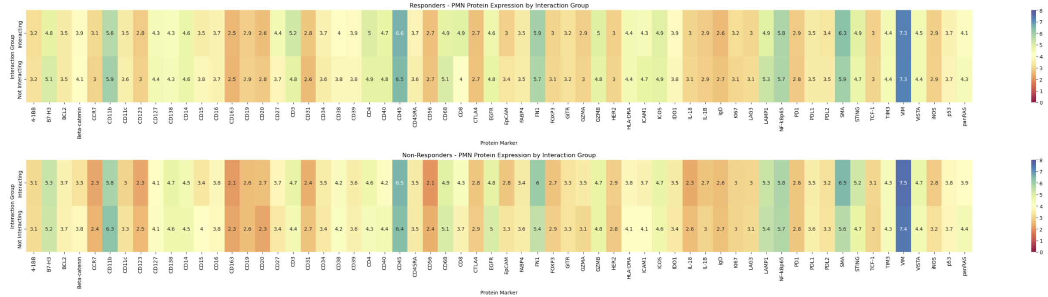
PMN-CD8 Sample Avg – PMN expression
Parameters: PMN protein expression, PMN>1% of cells, all genes
In general, there were not many notable findings. Genes largely in ling

Slide 4
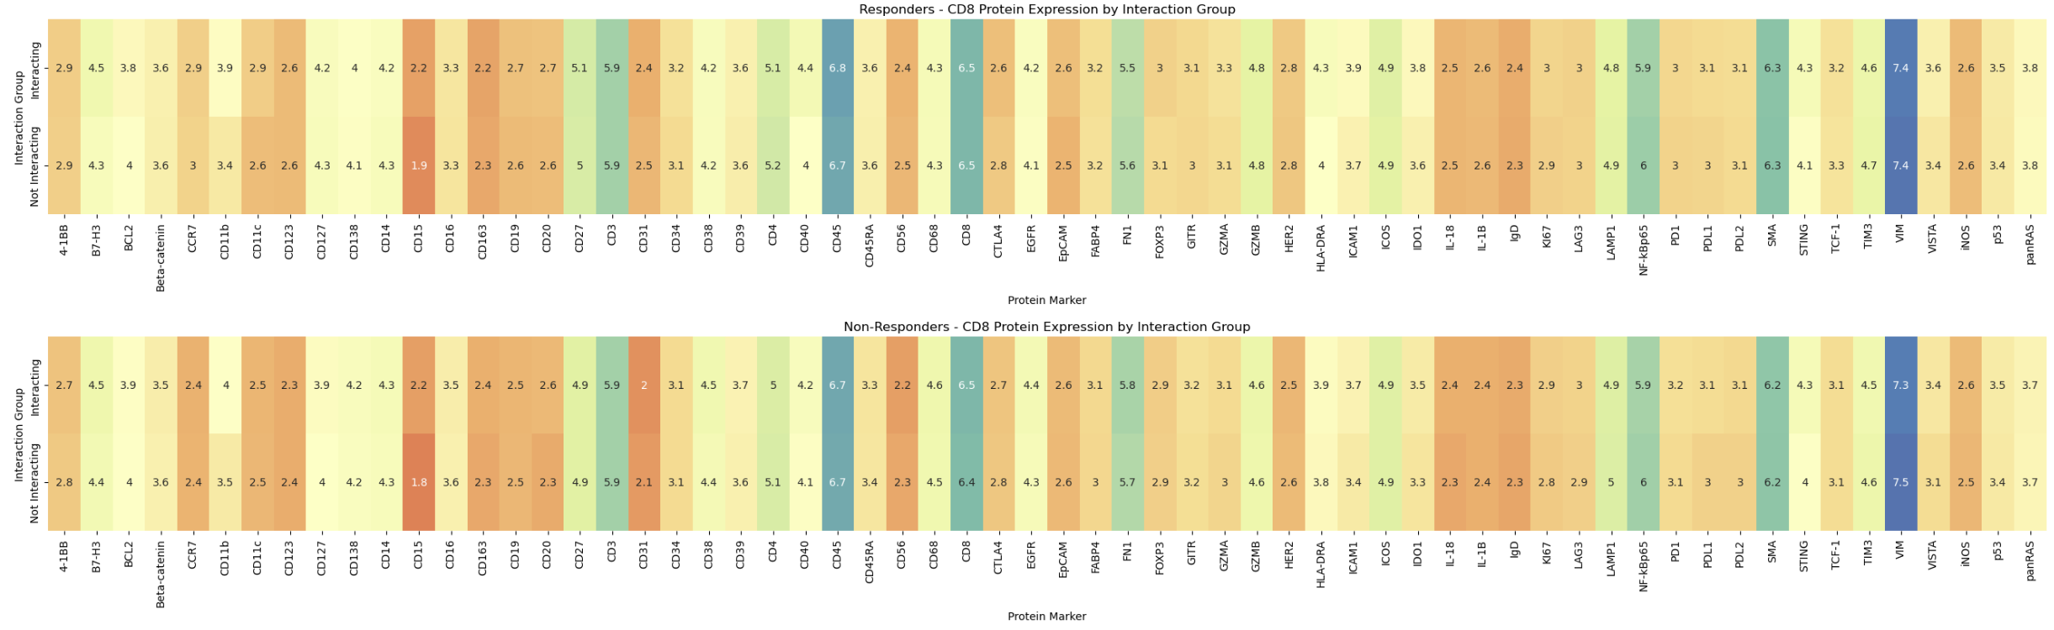
PMN-CD8 Sample Avg – CD8 expression
Parameters: CD8 protein expression, CD8>0.5% of cells, all genes
Most of the differences in expression average out

Slide 5
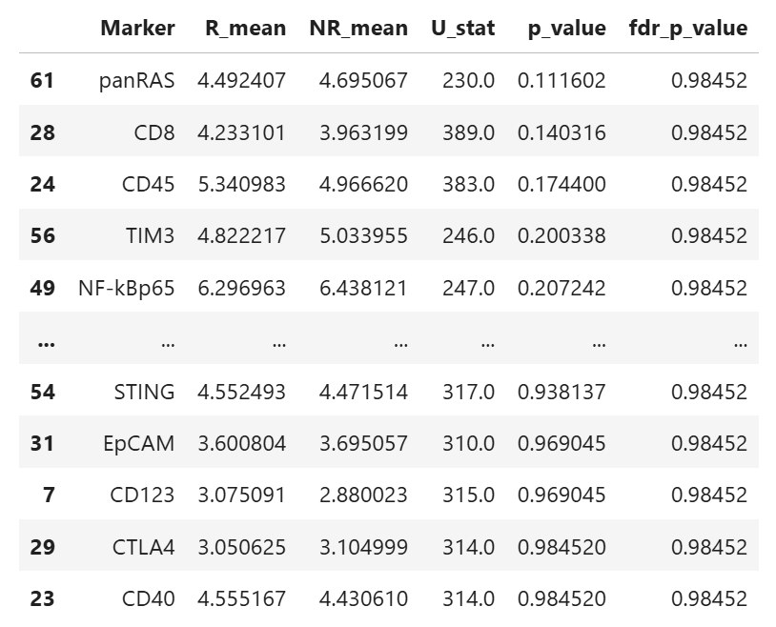
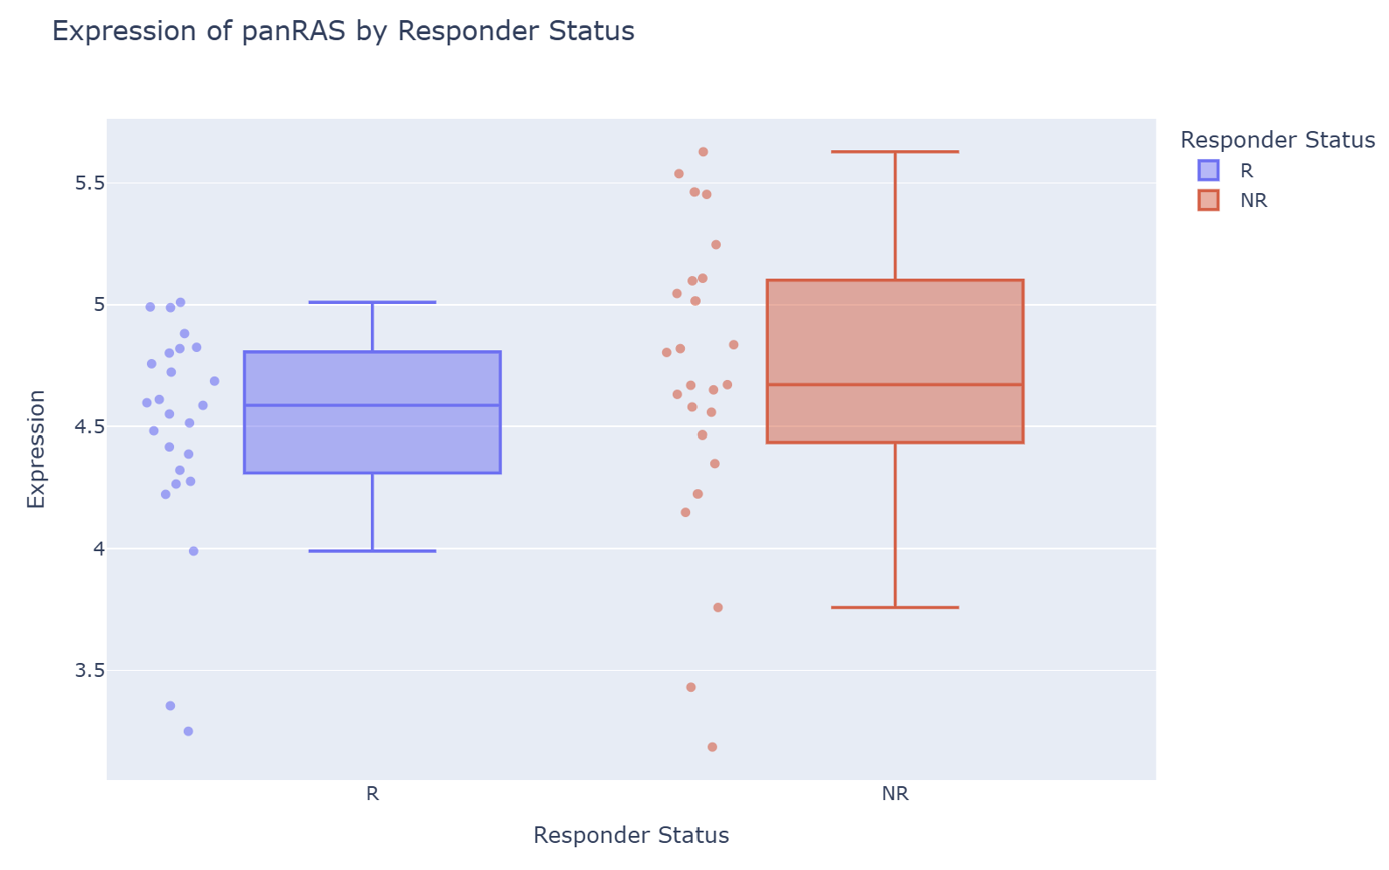
Statistical Significance PMN Gene Expression – R vs NR
Param: 0.5% pmn threshold
Each sample pmn expression averaged
Responder samples so no significant gene expression difference than non responders

Slide 6
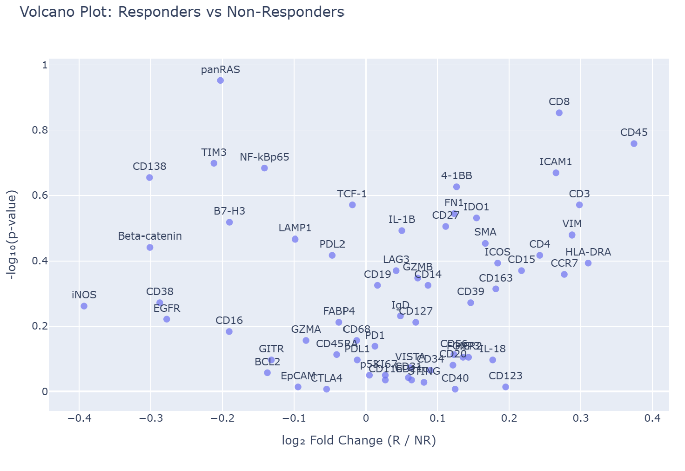
Volcano plot PMN
No significant findings in PMN expression

Slide 7
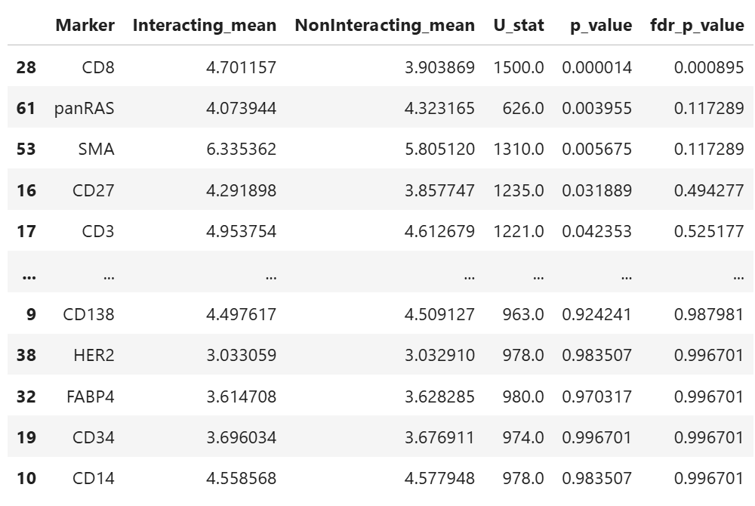
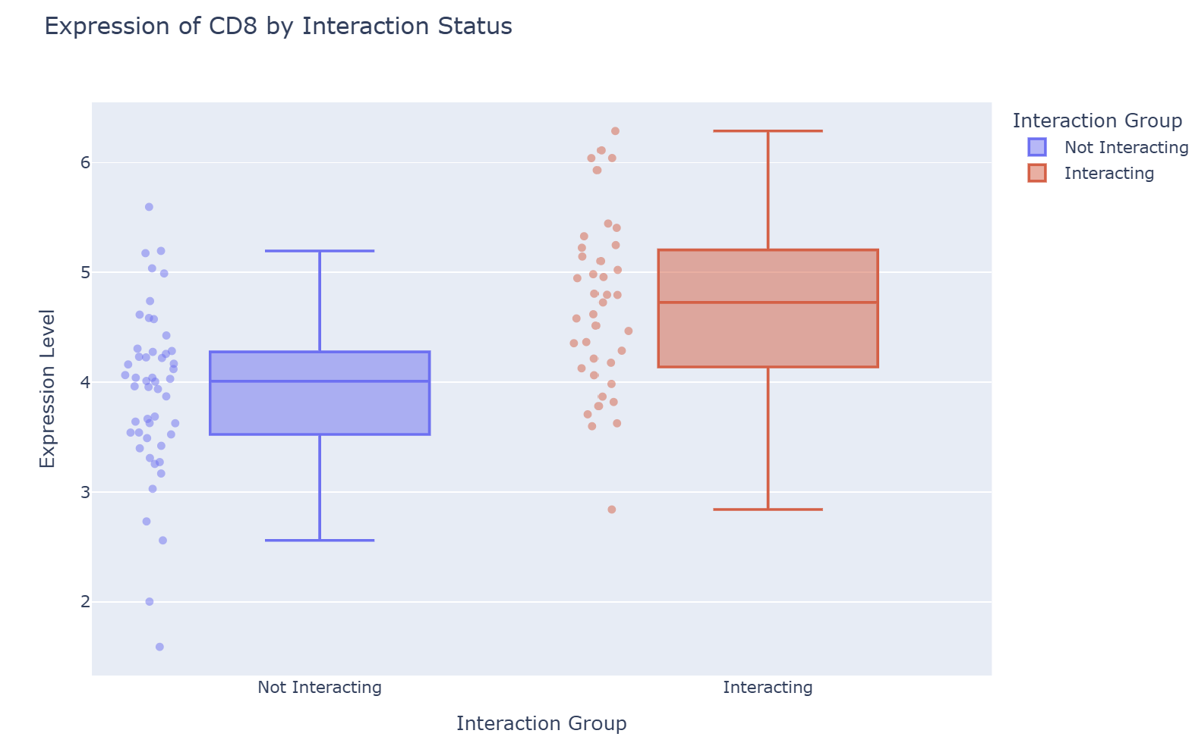
Statistical Significance PMN Gene Expression – Int vs Non Int
Param: 0.5% PMN threshold
Data includes both responder and non responder dataset
Interacting cells had potentially significant differences in CD8 (higher), panRAS (lower), SMA (higher)

Slide 8
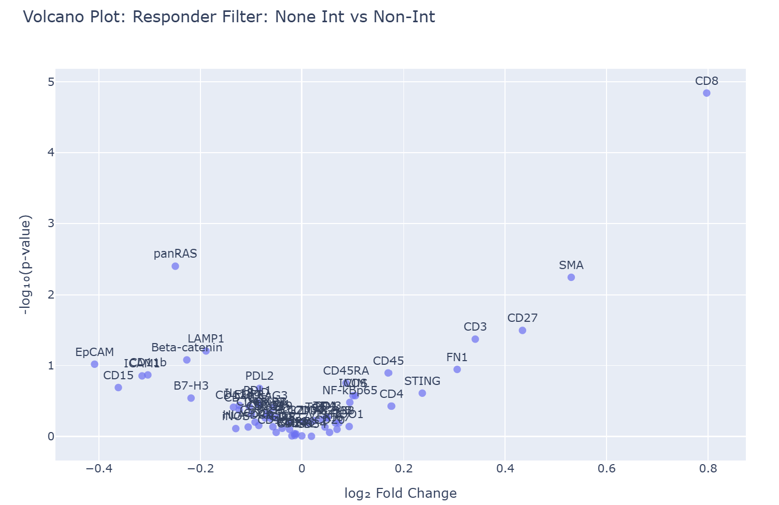
Volcano plot PMN-CD8 interacting vs. non interacting
No significant findings in PMN expression

Slide 9
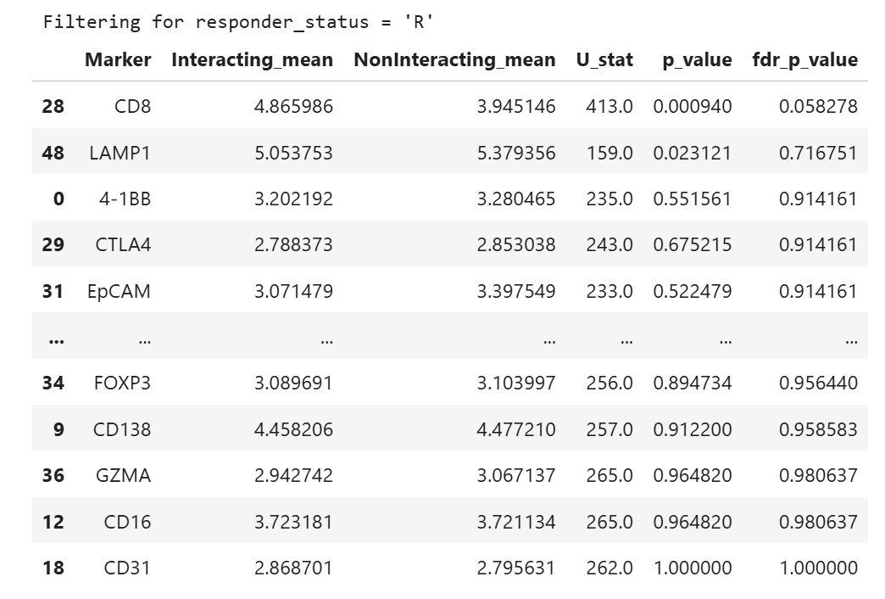
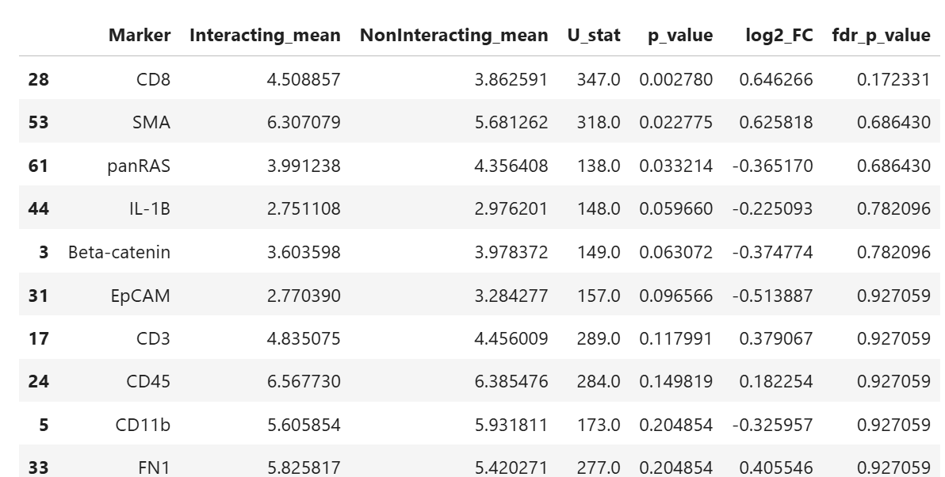
Statistical Significance PMN Gene Expression – Int vs Non Int plus NR and R
Responder
Non-Responder

Slide 10
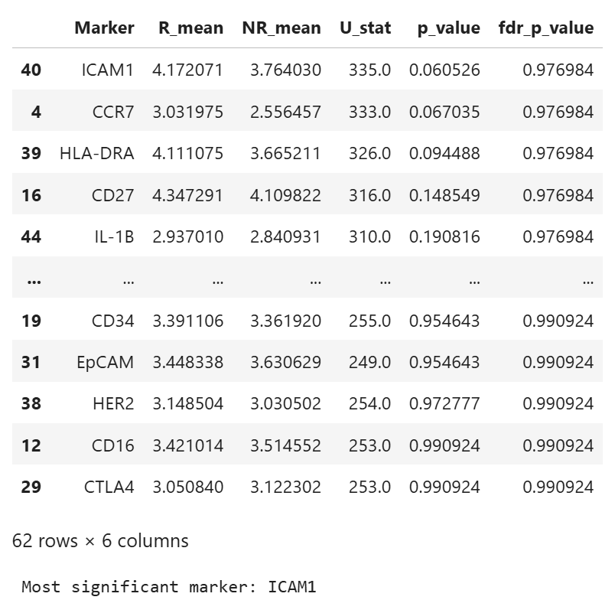
Statistical Significance CD8 Gene Expression – R vs NR
Param: 0.5% CD8 threshold
Each sample CD8 expression averaged
No notable differences

Slide 11
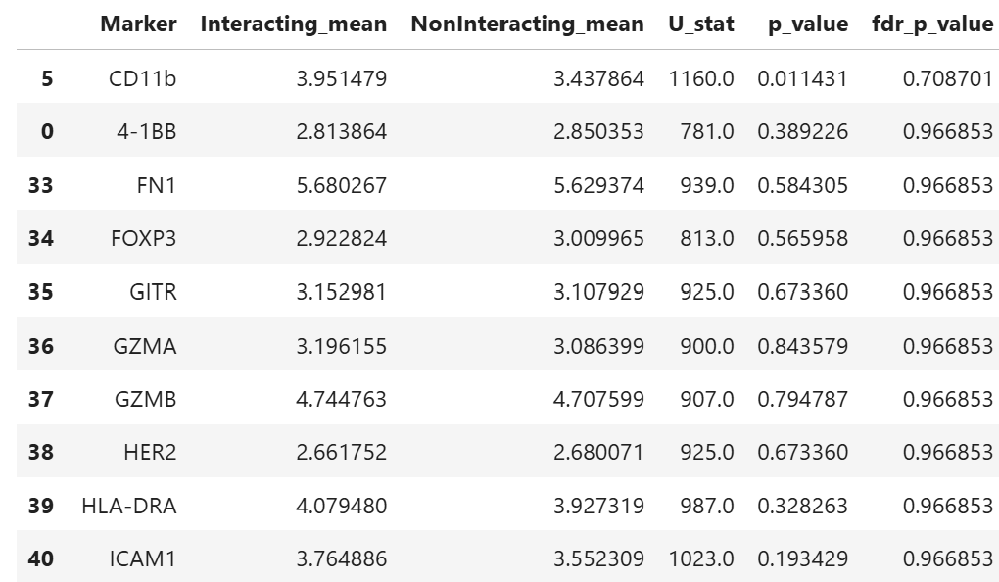
Statistical Significance PMN Gene Expression – Int vs Non Int
Param: 0.5% CD8 threshold
Data includes both responder and non responder dataset
No notable differences

Slide 12
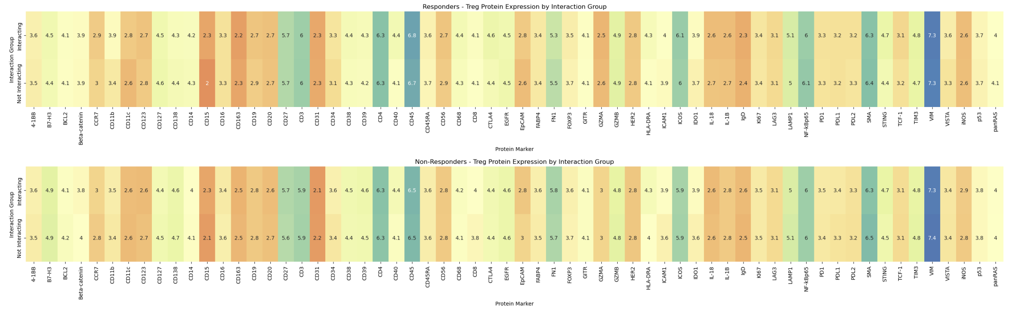
Treg Gene Expression – Interactions with neutrophils

Slide 13
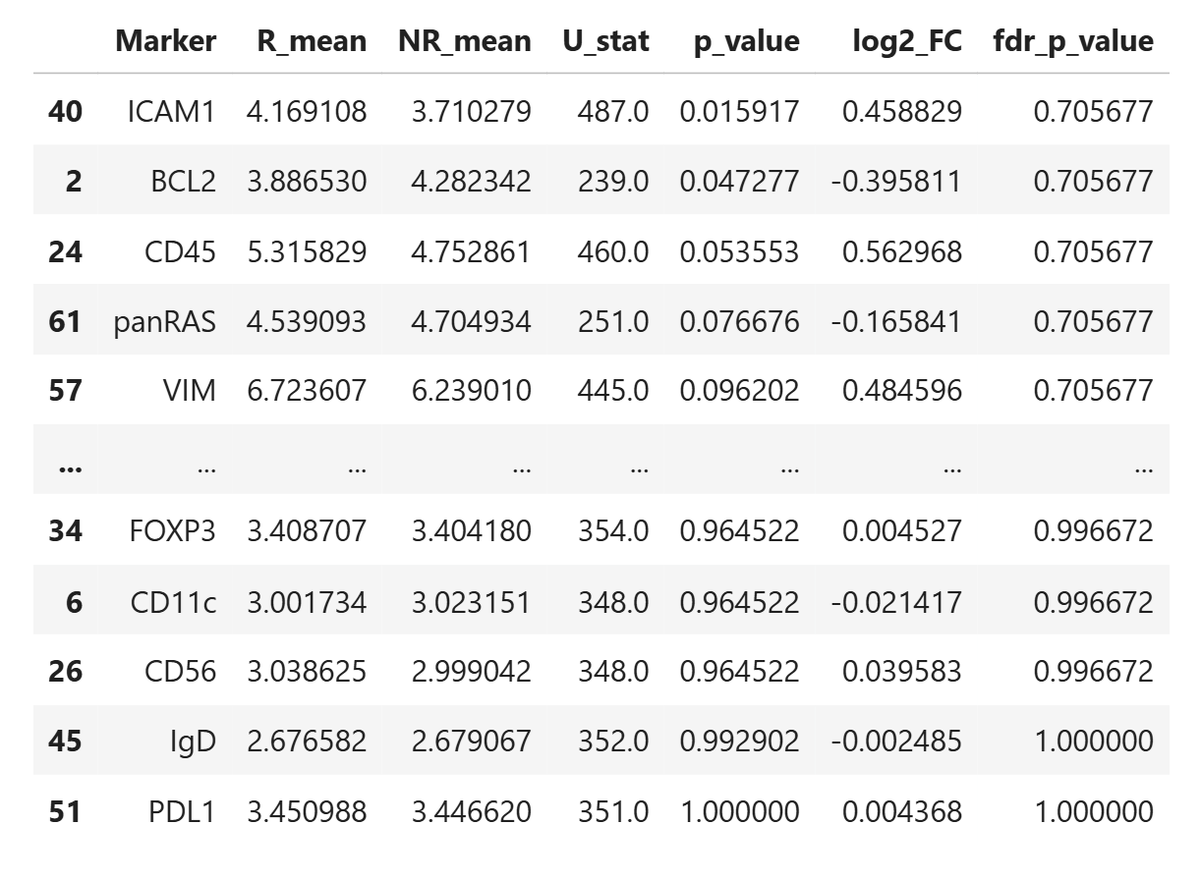
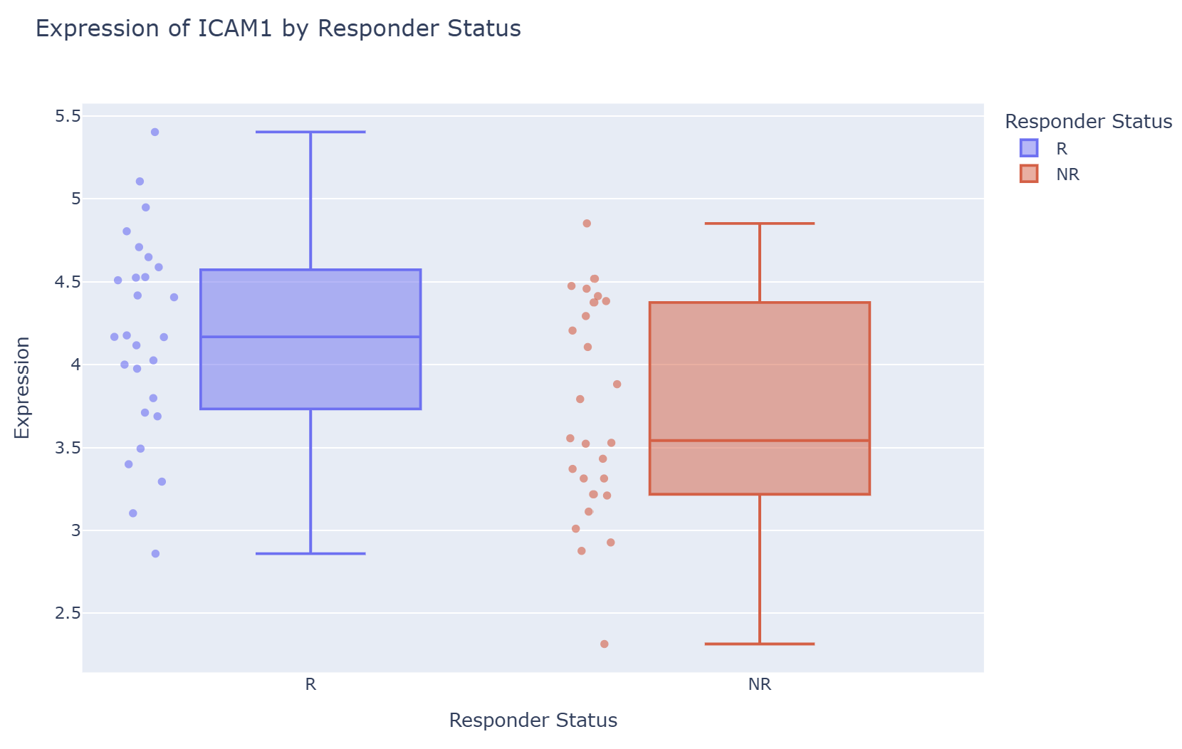
Statistical Significance Treg Gene Expression – R vs NR
Param: 0.25% pmn threshold
Each sample pmn expression averaged
Responder samples so no significant gene expression difference than non responders

Slide 14
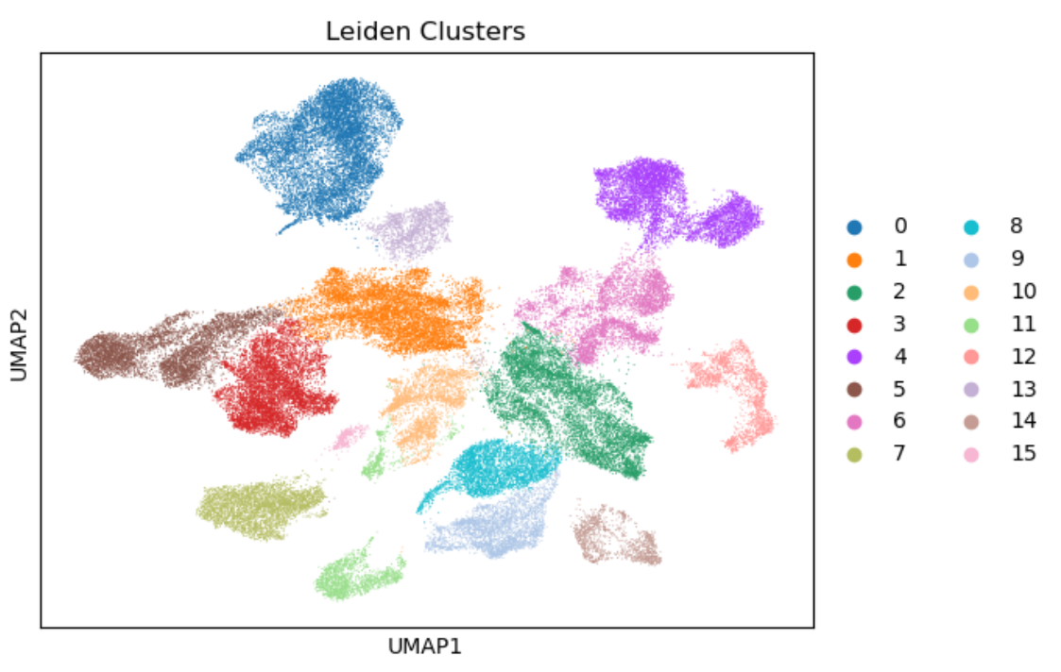
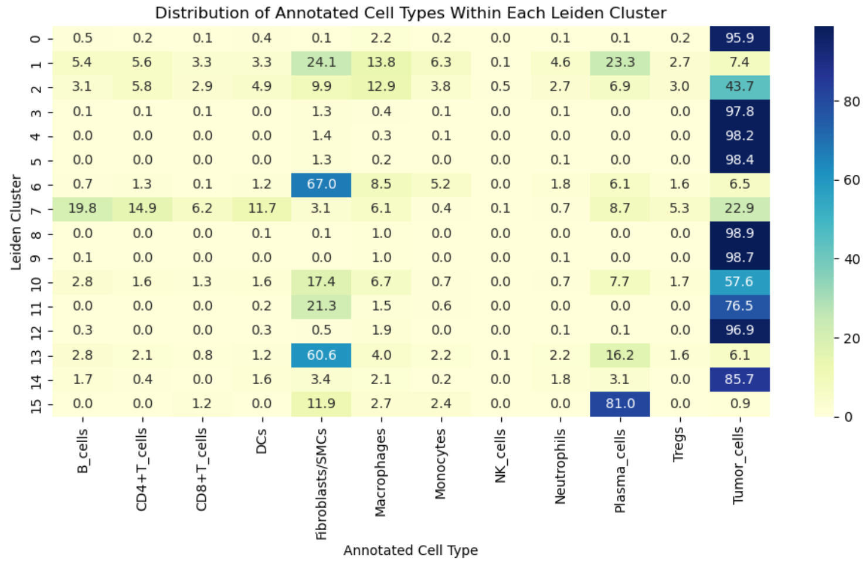
Lieden Clustering Protein Verification
One way to find neutrophils in the mRNA datasets would be use some sort of clustering software to find something that I am missing. Doesn’t align with current mappings. Reviewing Athena’s code to use specific markers

Slide 15
Future Directions
Comparing T-cell mRNA expression between samples with high colocalization and samples with low colocalization.
Requesting H&E images of the CosMX data
Lieden Clustering of the mRNA
Looking for cells with low overall mRNA expression as potential neutrophils.

